Slide 1
La Salle University One-Year MBA:
Designing an Effective Marketing Campaign
Nicole Fiamingo, Cassandre Luberus, Samantha Stupak
MBA 730- Marketing Research
April 28, 2011

Slide 2
Background
Current Industry Trend: One Year MBA Program Length
  Current Economic State
History of La Salle MBA Programs
  Part-Time
  Full-Time
  One Year
  Saturday MBA
Typical Advertising Campaign
Major Competitors
  Drexel University, Temple University, St. Joseph’s University, Villanova University, & Penn State University
Notes:
Increase in unemployment, has increased the need and desire for a one year MBA program
Part-Time (Student population) (when established)
Full-Time → Between 50 and 70 students. The program in 9 years old and Liz Scofield is the founding director
One Year- 521
Saturday MBA- 20 Students
Typical Advertising Campaign:
-Decisions for advertising the MBA Programs are made by Graduate Enrollment. The School of Business is not funded to advertise.
-Enrollment services purchased a list of students who will be graduating from college this spring and sent them an e-mail.
There are currently nine BS/MBA students and ten others. The projected enrollment is 25 students. Since many of your classes are given for all majors, we cannot enroll more than 25 unless we start another section.

Slide 3
Dear Students,
As graduation approaches, take some time to consider extending your education for 12 to 24 months to earn an MBA in one of La Salle University’s AACSB-accredited, internationally recognized programs. The programs are designed for recent graduates with limited work experience. Partial scholarships are available for U.S. and international students.
Information on the two programs follows:
One-Year MBA Program: This program is designed for students from all undergraduate majors to earn an MBA in one year. The program has three tracks: Investment Analysis, Managerial Finance, which also accommodates undergraduate accounting majors seeking to complete their 150-hour CPA requirement, and Marketing. The curriculum also offers students the opportunity to participate in faculty-led travel study.
Full-time MBA Program: This program is also designed for students from all undergraduate majors. Students in the program can begin classes in fall, spring and summer. Students complete this program in 12 to 24 months. It offers majors in accounting, finance, management, marketing, international business, and MIS. Students have the opportunity to study abroad for a full semester in this program or to participate in faculty-led travel study.
For more information on how to make your future brighter, visit our Web site at www.lasalle.edu/mba<http://eliteonlinetracking.com/.1p8k
LA SALLE UNIVERSITY
GRADUATE PROGRAMS
1900 West Olney Avenue
Philadelphia, Pennsylvania 19141-1199 USA

Slide 4
Research Purpose
Past Marketing Efforts
  Direct Mailing
Target Market
  Recent Business College graduates
Rate of success?
Notes:
La Salle University created a new one-year MBA program in 2010. The program was marketed through a direct mailing to a list of recent college graduates. This marketing effort was not considered to be successful in attracting the target market. In addition, the number of candidates desired was not met. The research project will attempt to determine the optimal target market and the most effective way to reach them.

Slide 5
Problem Definition
The marketing campaign was not able to achieve the level of response that was originally anticipated.
The marketing campaign did seek an optimal target market.
Notes:
The current marketing strategy employed by La Salle did not reach the level of response needed to meet optimal success for the program. The problem is evident because of two key points:
The marketing campaign was not able to achieve the level of response that was originally anticipated.
The marketing campaign did seek an optimal target market.
It is clear that the direct mailing strategy was not as successful as La Salle had anticipated. There are various other methods of advertising that could provide a better response, which includes: website appeal, search engine marketing, banner advertisements, and e-mail outreach. The first year participants that were attracted to the program were not the intended target market. La Salle focused on recent college graduates as their primary segment. However, a very small percentage of the first year students fit this description. By understanding the students who are most interested in the program, La Salle University can propose a marketing campaign that will better target these demographics.

Slide 6
Research Objectives
Students respond better to electronic media versus direct mailings.
Students find programs through search engines.
Students choose programs based on price, location, and program outline.
A student’s current employment status directly attributes to their desire to apply.
A program’s website has the potential to deter students from applying.
Those seeking a MBA program no longer fit in a typical demographical box.

Slide 7
Information Needs
Demographic information of current students
Career status of current students
Preferred search methods for MBA programs
Number of MBA programs applied to
Deciding factors for MBA programs

Slide 8
Survey Methodology
Sampling procedures
Sample size
Response Rate
Sample Representativeness
Notes:
Sampling procedures
*All OY, Full-time, and Part-time current MBA La Salle students
Sample size
*
Response Rate
*
Sample Representativeness
*OY Full Participation
*Full-time
*Part-time
We sampled what feel is the entire population, thus why we included the part and full-time MBA students as well. So that we may have a better representation of the true La Salle MBA student

Slide 9
Research Objectives Results
Students respond better to electronic media versus direct mailings.
Notes:
“Frequency” test results indicated that 48% of La Salle University’s MBA students first learned of the program by word of mouth.
Only 14.7% of respondents checking the “Search Engine” option.
Breaking down the responses to represent the separate MBA program (One-Year, Full-time and Part-time) results
-Results from the One-Year La Salle University students proves the majority (41%) selected the “other” option, followed by (25%) Social Media and (25%) radio promotions (Figure 2.1).
-Full-time student responses concluded that 64.7% of students first heard of La Salle University’s program by word of mouth, followed by 17 % selecting the “other” option, and thirdly, a tie between search engine and direct mailings at 11.8% (Figure 2.1).
-Part-time and Saturday La Salle University MBA students followed suit with the Full-time program results. Ranking word of mouth (50%) the highest response, followed by “other” (30%) and radio promotions (10.9%) (Figure 2.1).

Slide 10



Slide 11
Research Objectives Results
Students find programs through search engines.
Notes:
One Year La Salle University students ranked search engines (25%) as their second highest means of searching for MBA program information.
Survey question 13 asked respondents what their preferred search engines is? Results concluded that about 99.5% ranked google.com as their preferred search engine (Figure 3.1).
using keywords of “MBA program in Philadelphia, PA” (52%), “MBA program”(27%), “Part-time MBA Programs”(25%), and AACSB accredited MBA” (20%) (Figure 3.2).

Slide 13
Research Objectives Results
Students choose programs based on price, location, and program outline.

Slide 15
Research Objectives Results
A student’s current employment status directly attributes to their desire to apply.
Notes:
Approximately 78% of respondents were employed full time prior to their enrollment in a La Salle University MBA program. Results conclude that only about 16.5% of students previously unemployed prior to their enrollment (Figure 4.1).The research team feels that the percentage of unemployed respondents is directly attributed to the number (12%) of respondents pursuing an MBA degree directly from their undergraduate program (Figure 4.2).
Most respondents were fully employed prior to pursuing an MBA degree, and most respondents choose to further education not because of disappointment in their current employment status but because they are looking to better themselves and market themselves for career advancement.

Slide 17
Research Objectives Results
A program’s website has the potential to deter students from applying.
Notes:
95% of respondents did in fact review La Salle University’s website prior to applying.

Slide 19
Research Objectives Results
Those seeking a MBA program no longer fit in a typical demographical box.

Slide 20
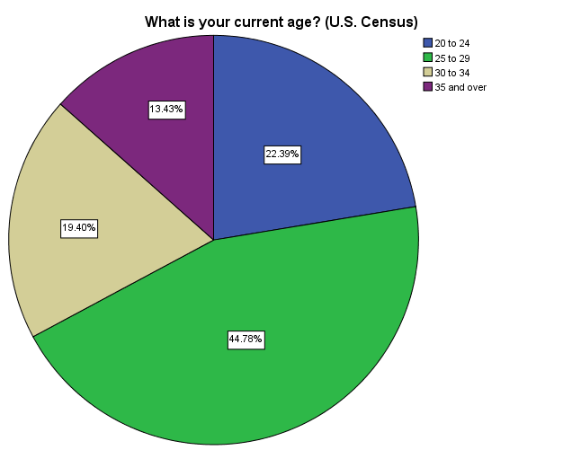
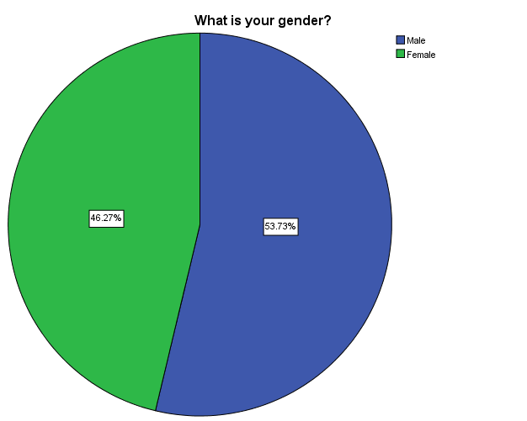

Slide 21
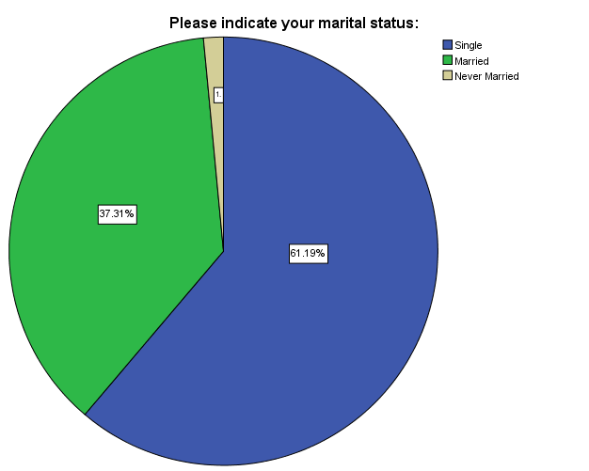
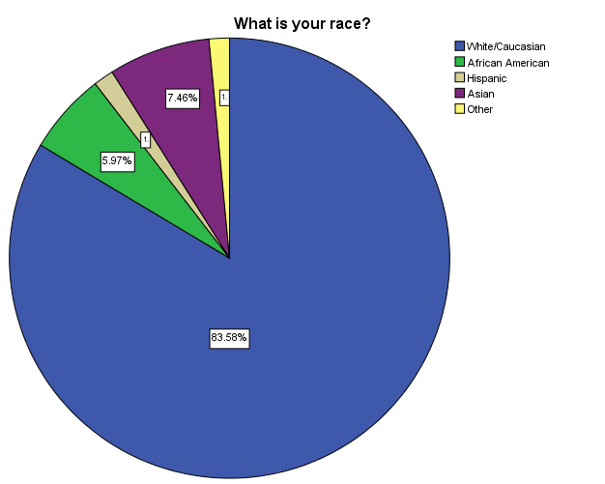

Slide 22
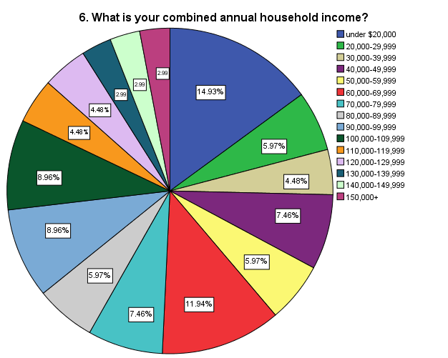

Slide 23
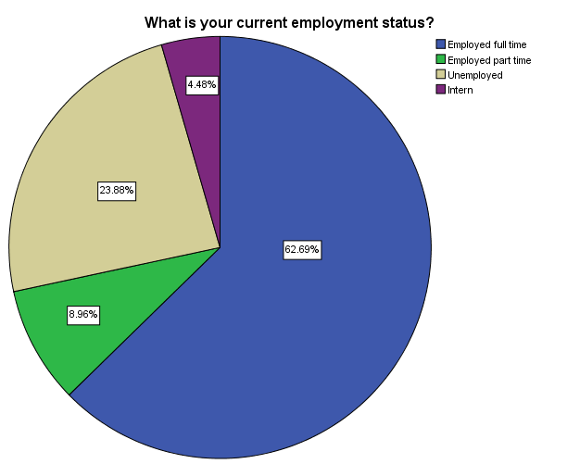
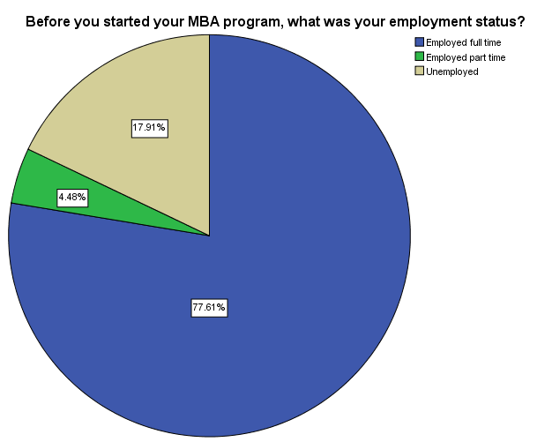

Slide 24
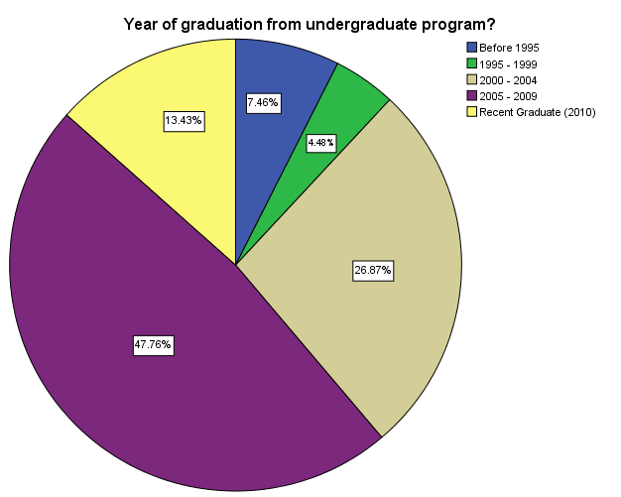
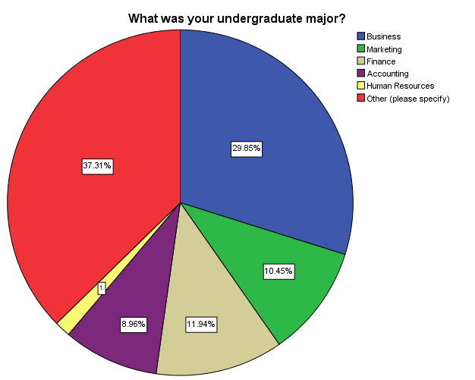

Slide 25
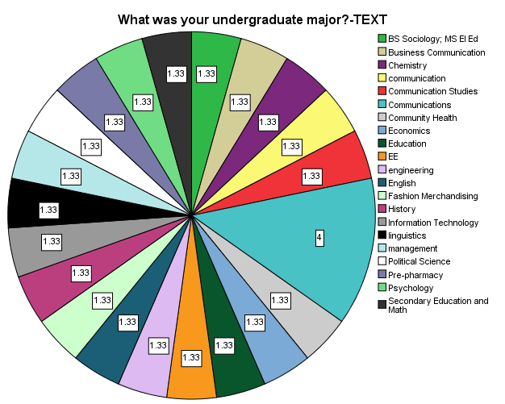

Slide 26
Managerial Recommendations
Spend less time and money on direct mailings and more on website banners and radio promotions
Revamp La Salle University and the School of Business website
Use better branding campaigns:
  Word of mouth
    “Go Ahead, Tell a Friend”
  “La Salle Endorsed”
  Search Engine Marketing
Promote the future growth possibilities that a MBA will present
Continue to promote price and location
Do extensive research on the demographics desired of future applicants

